Slide 1



ASSOCIATIVE CONTAINERS
A Quest Global Company

Slide 2
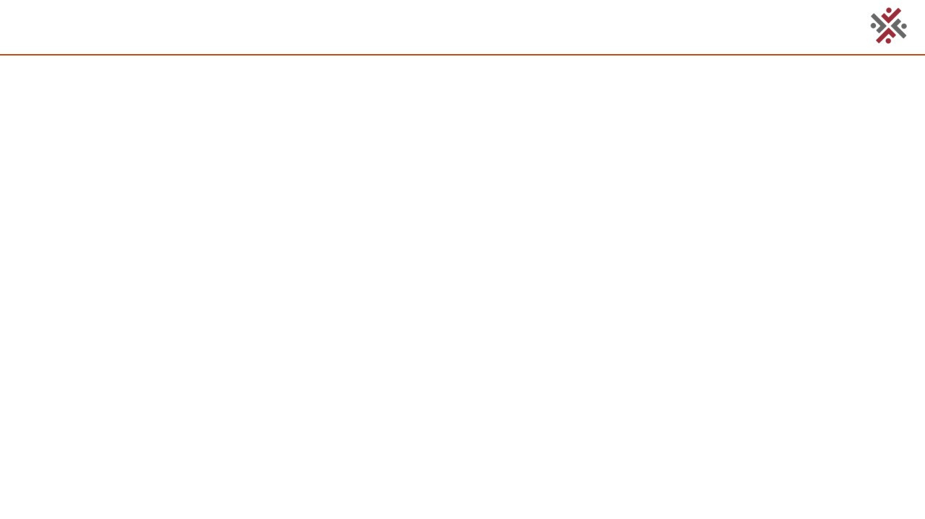
Overview
Introduction to Associative Containers
Types of Associative Containers
std::set
std::multiset
std::map
std::multimap
Iterators
Notes:
1.7.2013
‹#›

Slide 3
.
Introduction
ASSOCIATIVE CONTAINERS
Associative Containers are part of the Standard Template Library (STL) in C++.
They store data in sorted order using a key and allow fast searching, insertion, and deletion — usually in O(log n) time
Why we use :
To store data in sorted order
To perform fast search, insert, delete (O(log n))
To associate values with keys (e.g., names with phone numbers)
Unlike regular container like vector or list store data by index in the order you add it. They are fast for accessing by position but slower for searching. Use associative containers for key-based access, and arrays/vectors for index-based storage.
Notes:
1.7.2013
‹#›

Slide 4
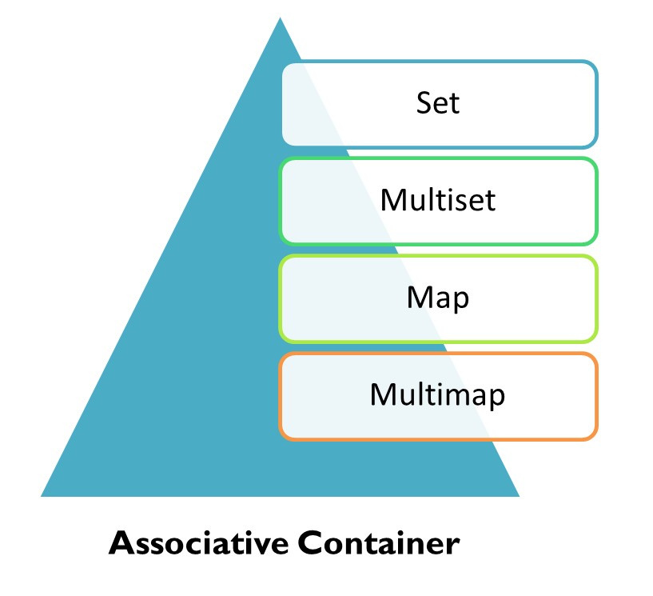
Types Of Containers
There are four main types of associative containers in C++:
set:
Stores unique elements, where the element value itself is the key.
multiset:
Similar to set, but allows duplicate elements.
map:
Stores key-value pairs, where each key is unique.
multimap:
Similar to map, but allows duplicate keys.
Notes:
1.7.2013
‹#›

Slide 5
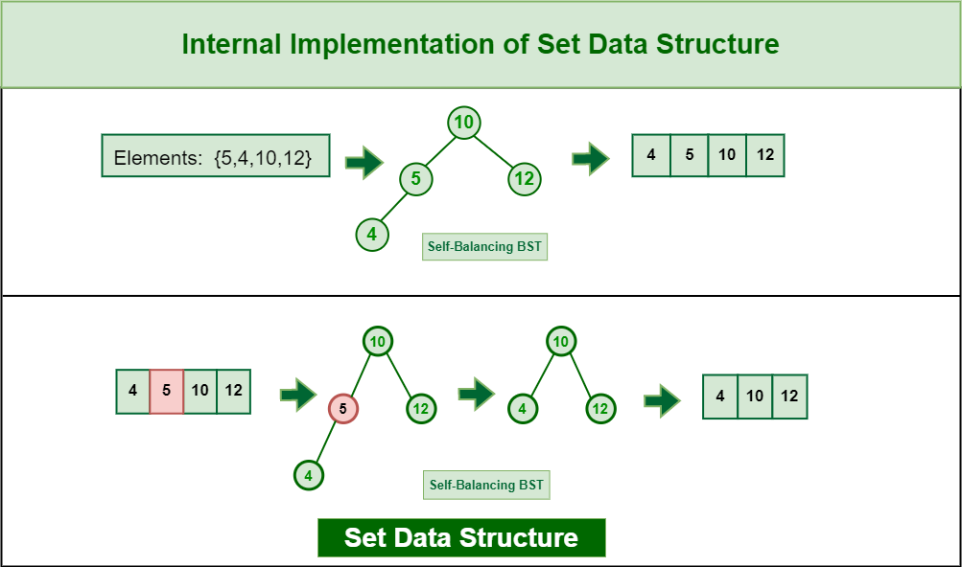
SETS
In C++, sets are associative container which stores unique elements in some sorted order. By default, it is sorted ascending order of the keys, but this can be changed as per requirement. It provides fast insertion, deletion and search operations.
Basic Operations :
clear(): Removes all elements from the multimap
insert(): Adds key-value pairs, allows duplicate keys
erase(): Removes elements by key, iterator, or range
find(): Returns iterator to first occurrence of key
count(): Returns the number of elements with a given key
We use sets to:
Keep only different (unique) items — no repeats.
Quickly check if something is there.
Keep items in order automatically.
Notes:
1.7.2013
‹#›

Slide 6
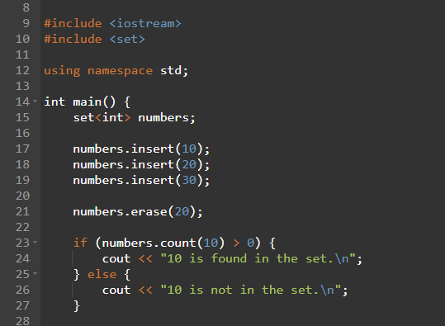
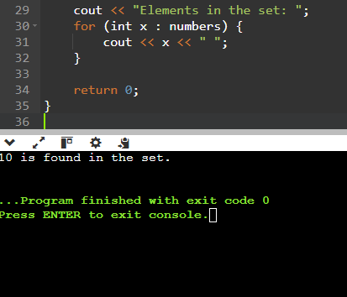
Code Implementation
Notes:
1.7.2013
‹#›

Slide 7
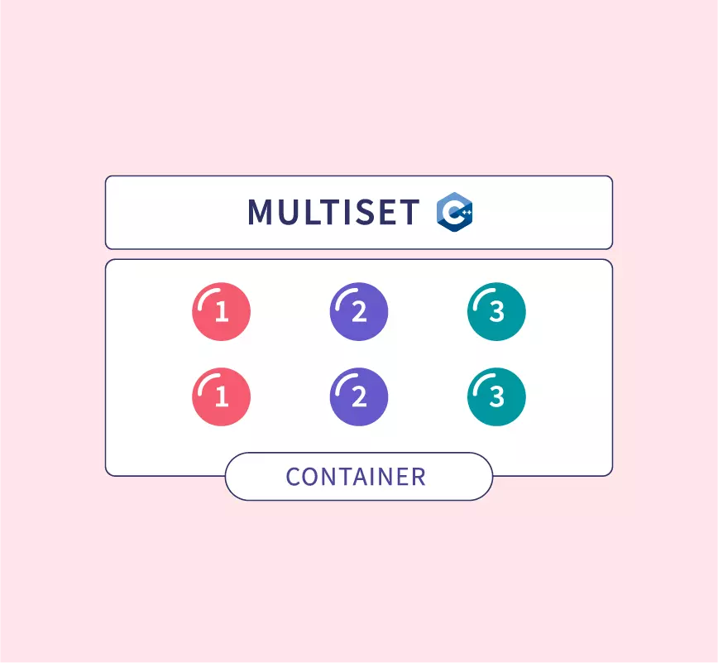
Std::Multi Set
In C++, multiset is an associative container similar to the set, but it can store multiple elements with same value. It is sorted in increasing order by default, but it can be changed to any desired order. It provides fast insertion, deletion and search operations.
Why we use:
Allows multiple occurrences of the same element (duplicates are allowed).
Automatically keeps elements sorted.
Provides efficient operations like insertion, deletion, and search.
Notes:
1.7.2013
‹#›

Slide 8
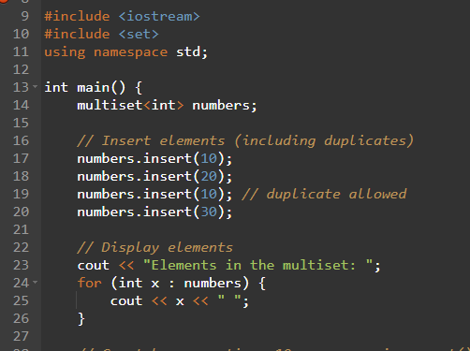
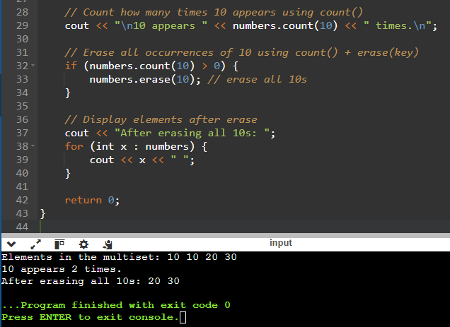
Code Implementation
Notes:
1.7.2013
‹#›

Slide 9
Sets vs MultiSets
std::set:
An associative container that stores unique elements in a sorted order. No duplicates are allowed.
std::multiset:
An associative container that stores elements in a sorted order, but allows duplicate elements.
Feature | std::set | std::multiset
Duplicates | Not allowed | Allowed
Ordering | Sorted (by default ascending) | Sorted (by default ascending)
Element uniqueness | Unique keys only | Multiple identical keys allowed
Insertion behavior | Ignores duplicate insertions | Inserts all elements, including duplicates
Use case | When unique elements are needed | When duplicates need to be stored
Search complexity | O(log n) | O(log n)
Iterator behavior | Iterates unique elements | Iterates all elements, including duplicates
Notes:
1.7.2013
‹#›

Slide 10
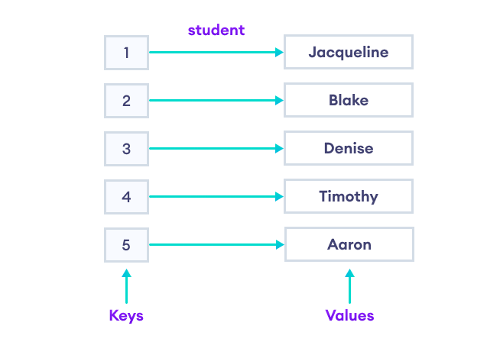
Maps
In C++, maps are associative containers that store data in the form of key value pairs sorted on the basis of keys. No two mapped values can have the same keys. By default, it stores data in ascending order of the keys, but this can be changes as per requirement.
Why we use maps :
Store data as pairs: a key and its value (like a dictionary).
Quickly find the value using the key and no duplicates are allowed
Notes:
1.7.2013
‹#›

Slide 11
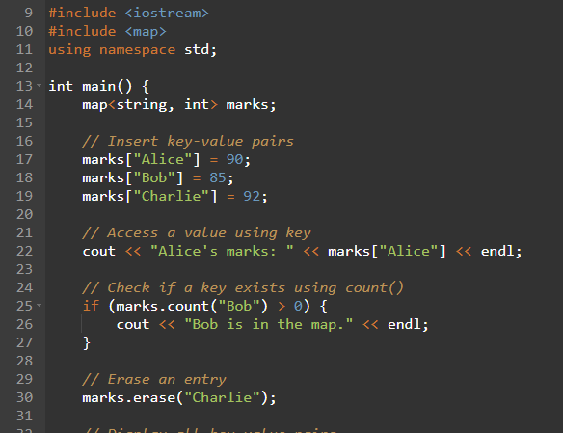
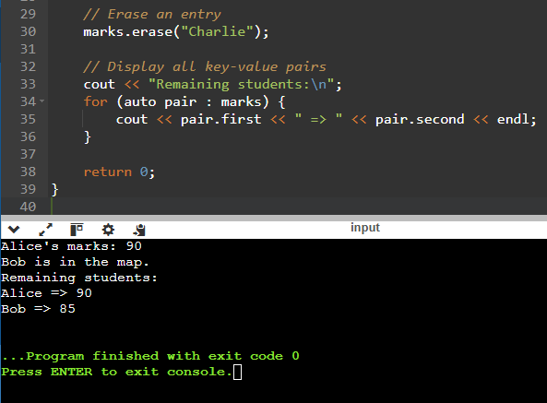
Code Implementation
Notes:
1.7.2013
‹#›

Slide 12
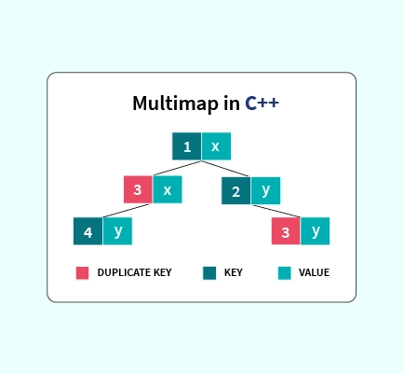
MultiMaps
In C++, multimap is an associative container similar to map, but it can have multiple elements with same keys. It stores all the elements in increasing order based on their keys by default but can be changed if required. It provides fast insertion, deletion and search on this sorted data.
Why we use:
We use multimap when one key has many values.
The same key can appear more than once.
The keys are always kept in order.
Notes:
1.7.2013
‹#›

Slide 13
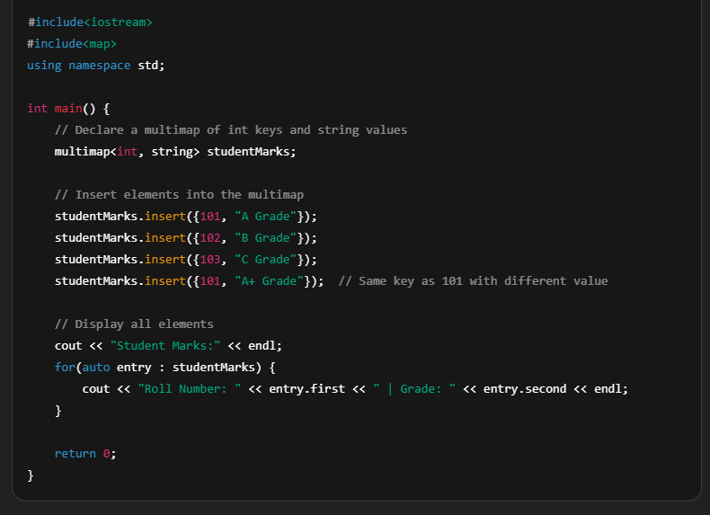
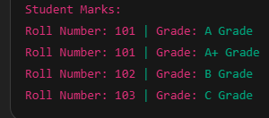
Implementation of MultiMaps
Notes:
1.7.2013
‹#›

Slide 14
Maps VS MultiMaps
Map:
A collection of key-value pairs where each key is unique. You cannot have two entries with the same key.
Multimap:
A collection of key-value pairs where keys can repeat. Multiple entries can have the same key
Feature | std::map | std::multimap
Key Uniqueness | Keys are unique | Keys can have duplicates
Key-Value Storage | One value per key | Multiple values per key (one-to-many)
Insert Behavior | Ignores insert if key exists | Allows multiple inserts for same key
Access Operator | Supports [] for access/modification | Does not support [] operator
Ordering | Sorted by key (default ascending) | Sorted by key (default ascending)
Use Case | When each key maps to exactly one value | When keys may map to multiple values
Underlying Structure | Balanced BST (usually Red-Black Tree) | Balanced BST (usually Red-Black Tree)
Notes:
1.7.2013
‹#›

Slide 15
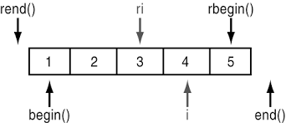
Iterators
An iterator is an object (like a pointer) that points to an element inside a container (like a vector, list, or map) and allows you to traverse the container elements one by one.
Iterator Functions of Containers
begin() — returns iterator to the first element
end() —returns iterator past the last element (not dereferenceable)
rbegin() and rend() — reverse iterators
Notes:
1.7.2013
‹#›

Slide 16
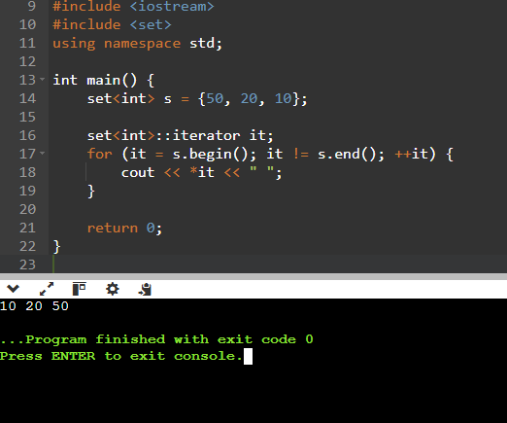
Implementation
Notes:
1.7.2013
‹#›

Slide 17



Thank You

